Slide 1
Token-level author diarization using clustering of stylistic contexts
University of Zagreb, Faculty of Electrical Engineering and Computing
Ivan Grubišić, Milan Pavlović, Mate Šimović
Text analysis and retrieval course
academic year 2016./2017.

Slide 2
Outline
Our tasks
The proposed approach
Results
Demo

Slide 3
Task a: Intrinsic plagiarism detection (from PAN 2016 @ CLEF)
"She is also a successful businesswoman and an American icon, was born in Jersey City to middle-class Polish-American parents and she earned a partial scholarship to …"
Find plagiarized parts of a document in which at least 70% of text is written by main author
Only a number of authors is known (2*)
Intrinsic: without any comparisons with external sources
71 document in the training set

Slide 4
Task b: Author diarization with known number of authors (from PAN 2016 @ CLEF)
General author diarizaton problem
Decompose the text into authorial components and assign an author label to the each component
Number of authors is known (between 2 and 10)
55 documents in the training set

Slide 5
Task c: Author diarization with unknown number of authors (from PAN 2016 @ CLEF)
?
The number of authors is unknown
54 documents in the training set

Slide 6

The proposed approach
Brooke et al. (2013): a more radical approach would not separate the described tasks in segmentation and clustering steps, but rather build authorial segments that would also form good clusters
Clustering of stylistic contexts of all tokens
Input document
Tokenization
Basic feature extraction
Feature transformation
Clustering
Notes:
We decided to cluster tokens according to authors by looking at the writing
Our approach was based on previous work from authorship analysis where the main assumption
Is that every author has its own unique writing style. -> places -> token level > clustering tokens by authror ->
Not alone -> stylistic contexts

Slide 7
The proposed approach
Input document
Tokenization
Basic feature extraction
Feature transformation
Clustering
Basic features are extracted from a sliding window which moves from token to token and includes the context of each token
„…She is also a successful businesswoman and an American icon, was …"
Stop words (156)
Character tri-grams (200)
Special characters (*)
POS tag counts (12)
Average token length (1)
Bag of Words (100)
Type-token ratio* (1)

Slide 8
The proposed approach
Input document
Tokenization
Basic feature extraction
Feature transformation
Clustering
All features
Context sizes:
16 tokens for Task a
140 tokens for tasks b and c
Character trigrams, BoW, stop words, average token length
Context size: 120 tokens

Slide 9
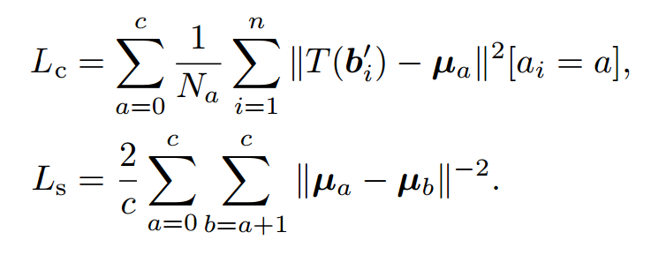
The proposed approach
Input document
Tokenization
Basic feature extraction
Feature transformation
Clustering
Model A:
Model B:
Feature scaling to zero mean and unit variance
A trainable transformation to adapt the feature space for clustering
Linear (output dimension 40) or elementwise linear transformation T
Compactness loss and segregation loss
Notes:
Lc is proportional to the average variance of groups
Ls penalizes centroids being too close to each other
The compactness loss Lc is a weighted sum of within-group variances. The segregation loss Ls is proportional to the sum of magnitudes (not magnitude of the sum) of forces between c equally charged particles each located at one of the centroids.

Slide 10
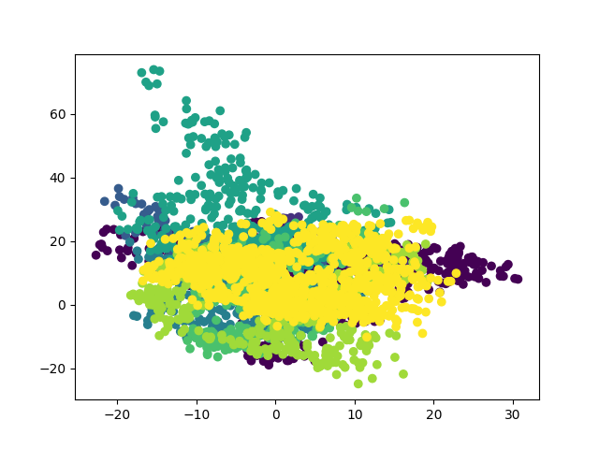
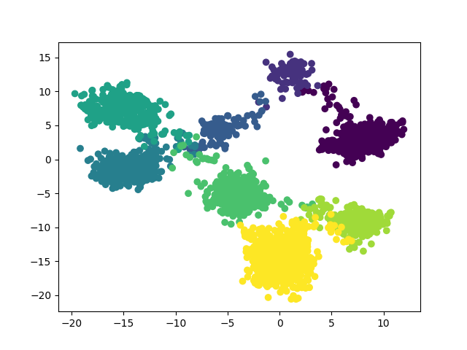
The proposed approach
Input document
Tokenization
Basic feature extraction
Feature transformation
Clustering
Model B: linear transformation with 2-dimensional output trained on one document - demonstration of separability of authors using character trigram frequencies as features
Notes:
Animation here?

Slide 11
The proposed approach
Input document
Tokenization
Basic feature extraction
Feature transformation
Clustering
Model A:
Model B:
A training and a test set
Grid search on the training set over several algorithms on all tasks
Development set (70% of the data) split into a training set and a validation set for the feature transformation
30% of data left for the test set

Slide 12
The proposed approach
Input document
Tokenization
Basic feature extraction
Feature transformation
Clustering
Model A:
Model B:
Task a: Agglomerative clustering with cosine affinity and average linkage
Task b: Agglomerative clustering with Euclidean affinity and average linkage
Task c: DBSCAN (eps=0.23, min_samples=64, metric=cosine)
All tasks: k-means
Tried automatic cluster number prediction using the elbow rule for Task c and outlier elimination for Task a

Slide 13
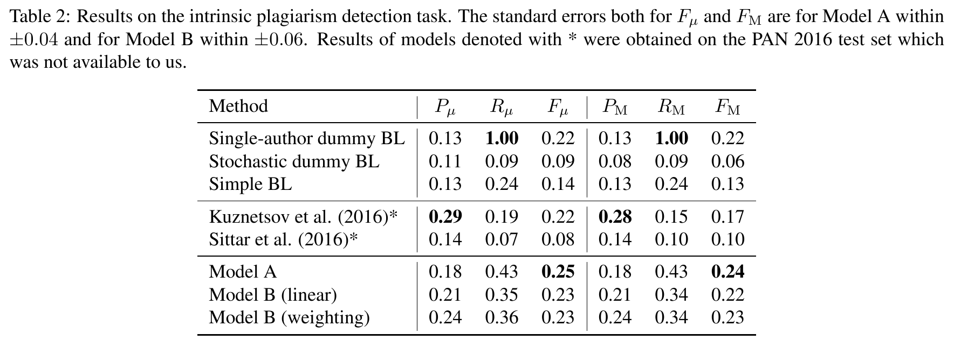
Results – Task a
Notes:
Our results are not good, 95% lower limit is below single-author BL, better than kuznetsov*

Slide 14
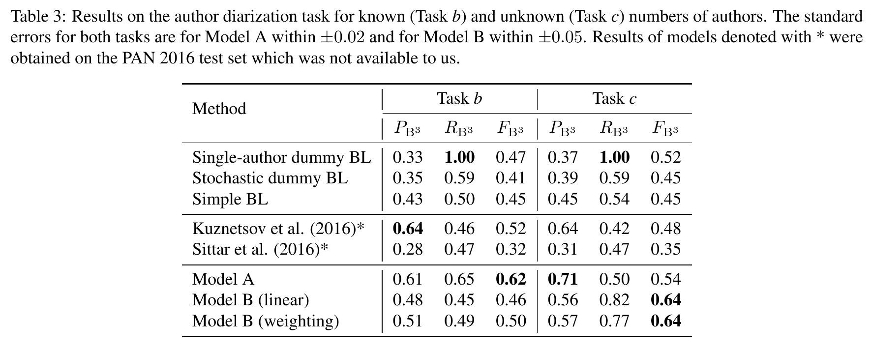
Results – tasks b and c
Notes:
Mention that Model B in the table uses 2 groups for k-means and the problems with the Bcubed score.

Slide 15
Demonstration
Feature transformation training on a single document

